Slide 1

Panimate pre-PowerPoint
Make your idea
easier to see.
A visual story for your next
business conversation.
Panimate / pre-PowerPoint
1 / 6
Notes:
Panimate pre-PowerPoint helps you turn an idea into a clear visual story before the bigger presentation or partner conversation. Sam works with you on the message, the images and the way you present it.

Slide 2
Start with the decision.
1
2
3
Who is it for?
What should they see?
What happens next?
One audience
One clear idea
One useful next step
Panimate / pre-PowerPoint
2 / 6
Notes:
First, tell Sam who you are speaking to, what they need to understand and what you want to happen next. We shape the story around that conversation, using your facts and your language.

Slide 3
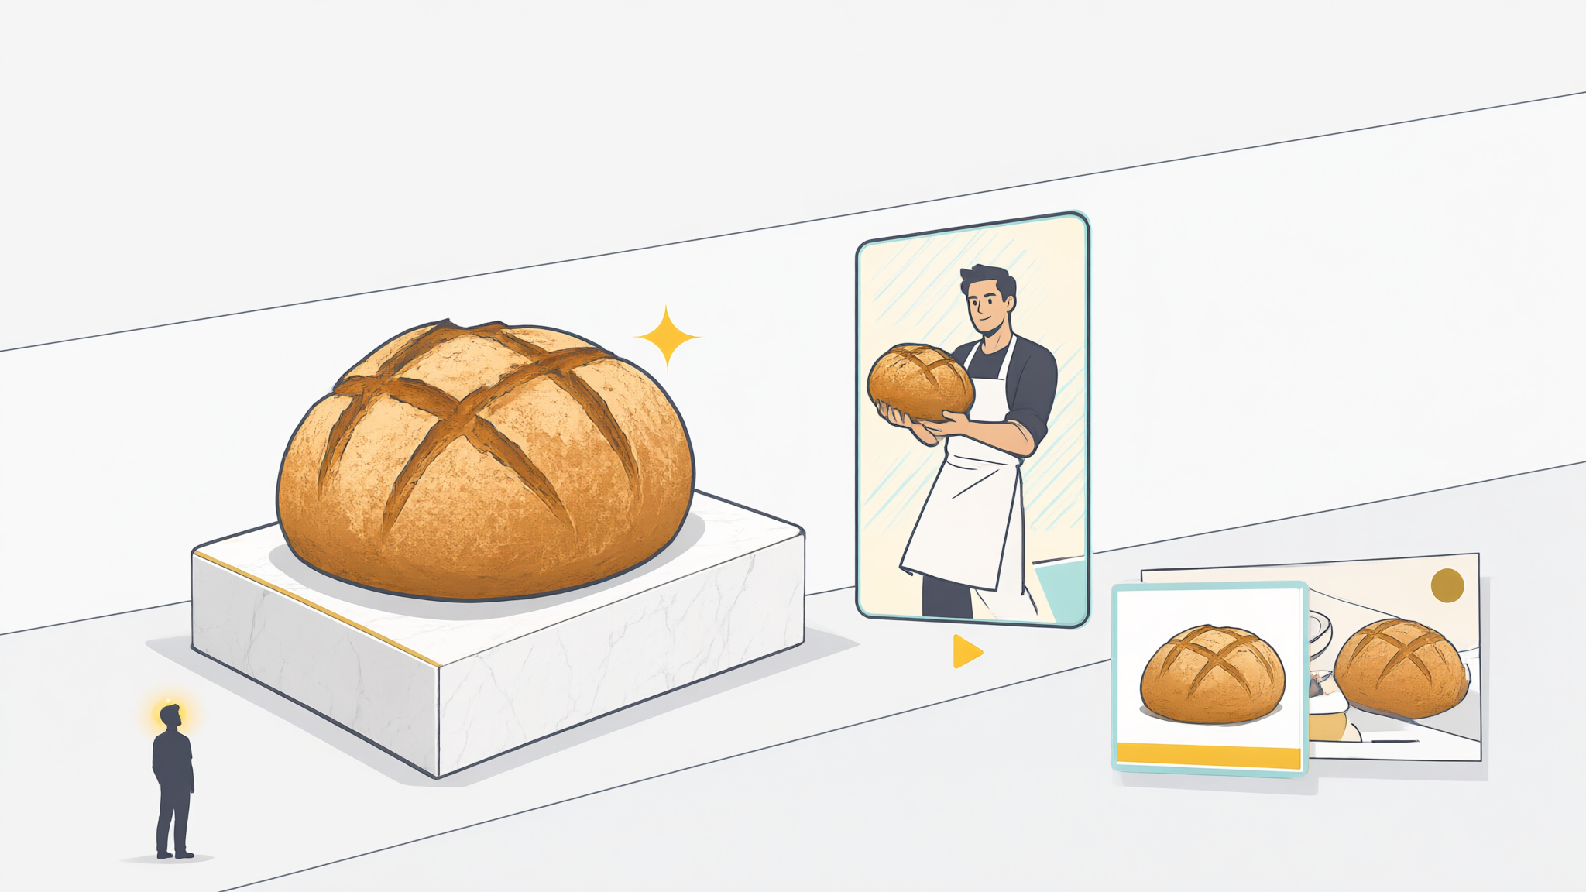
Show what words
leave to the imagination.
Panimate / pre-PowerPoint
3 / 6
Notes:
A useful visual makes the idea concrete: how something works, what changes and why it matters. These illustrations demonstrate a visual storytelling approach; they do not depict a client implementation or measured result.

Slide 4

For the room.
For the person outside it.
Internal initiatives
Partner conversations
A short video to share
Panimate / pre-PowerPoint
4 / 6
Notes:
Use the presentation to explain an initiative inside your company or introduce an idea to a business partner. A short video can carry the same story when you cannot be in the room yourself.

Slide 5
Your idea. A story we build together.
Bring it
Shape it
Show it
Notes, a voice memo
or an existing deck.
A clear story and
visuals with Sam.
A presentation or video
for your audience.
Panimate / pre-PowerPoint
5 / 6
Notes:
Bring rough notes, a voice memo or an existing presentation. Sam helps shape a first visual story, reviews it with you and agrees the right presentation or video format for your audience.

Slide 6
Try one idea.
Book a free consultation
Ask Sam for your free idea presentation.
Panimate / pre-PowerPoint
6 / 6
Notes:
Book a free consultation with Sam and ask for your free idea presentation. We will choose one idea and one audience to start with, and discuss what a useful first example should show.

